Slide 1
Support Multiple Screens
Author: Sonny Shih
Date: 2016/06/08

Slide 2
Overview
官方網站
https://developer.android.com/guide/practices/screens_support.html?hl=zh-tw#testing
官方提供各裝置規格資料
https://design.google.com/devices/

Slide 3
Terms and concepts (1/6)
Screen Size
Actual physical size, measured as the screen's diagonal.
Small,
Normal
Large,
Extra-large

Slide 4
Terms and concepts (2/6)
Screen density
The quantity of pixels within a physical area of the screen.
Referred to as dpi (dots per inch)
Low
Medium
High
Extra-high
Extra-extra-high
Extra-extra-extra-high
Notes:
參考網站: http://ayu6628.pixnet.net/blog/post/4807174-%E8%A7%A3%E6%9E%90%E5%BA%A6%E3%80%81dpi%E3%80%81ppi%E4%B9%8B%E9%96%93%E7%9A%84%E8%BF%B7%E6%80%9D
dpi : dots per inch (設備解析度, 印表機使用)
ppi: pixels-per-inch (數位解析度, 圖檔使用)

Slide 5
Terms and concepts (3/6)
Orientation
Rotates the device
Landscape
Portrait

Slide 6
Terms and concepts (4/6)
Resolution (解析度)
Applications should be concerned only with screen size and density.

Slide 7
Terms and concepts (5/6)
Density-independent pixel (dp)
A virtual pixel unit that you should use when defining UI layout, to express layout dimensions or position in a density-independent way.
The density-independent pixel is equivalent to one physical pixel on a 160 dpi screen, which is the baseline density assumed by the system for a "medium" density screen
Notes:
1. The density-independent pixel is equivalent to one physical pixel on a 160 dpi screen
(density-independent pixel 相當於 160 dpi 螢幕上的一個 physical pixel )
2. 以160 dpi 螢幕當 baseline (medium)

Slide 8
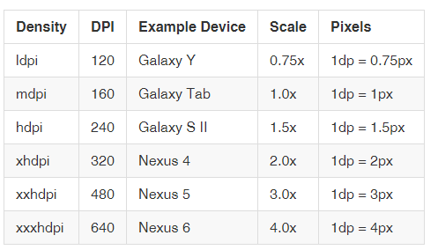
Terms and concepts (6/6)
px = dp * (dpi / 160)
Ex: On a 240 dpi screen, 1 dp equals 1.5 physical pixels
1.5 = 1 * (240/160)

Slide 9
Range of screens supported (1/3)
Screen Size
small (screens are at least 426dp x 320dp)
normal (screens are at least 470dp x 320dp)
large (screens are at least 640dp x 480dp)
xlarge (screens are at least 960dp x 720dp)

Slide 10
Range of screens supported (2/3)
Screen Density
ldpi (low) ~120dpi
mdpi (medium) ~160dpi
hdpi (high) ~240dpi
xhdpi (extra-high) ~320dpi
xxhdpi (extra-extra-high) ~480dpi
xxxhdpi (extra-extra-extra-high) ~640dpi
圖片比例為
120:160:240:320:480:640 =>
0.75:1:1.5:2:3:4

Slide 11
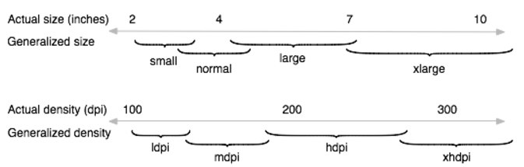
Range of screens supported (3/3)
Baseline Configuration
normal size (values)
mdpi (medium) density (drawable-mdpi)
Illustration of how Android roughly maps actual sizes and densities to generalized sizes and densities (figures are not exact).

Slide 12
Density independence
The Android system helps your application achieve density independence in two ways:
The system scales dp units as appropriate for the current screen density
The system scales drawable resources to the appropriate size, based on the current screen density, if necessary

Slide 13
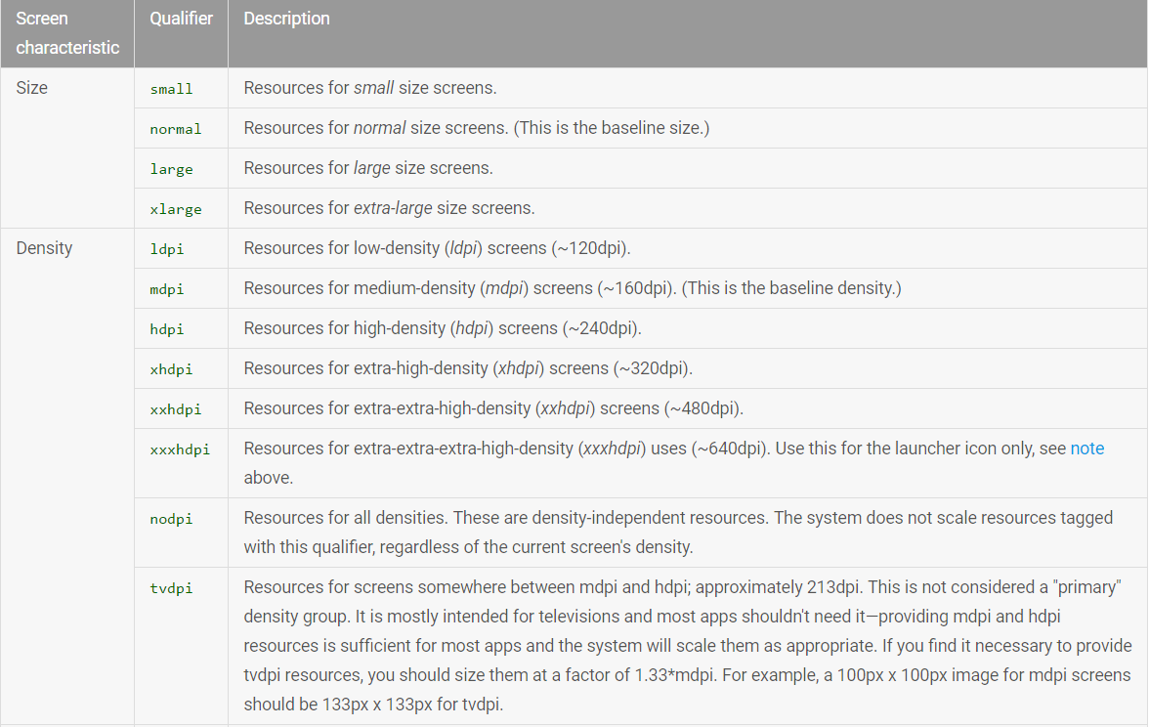
Configuration qualifiers (1/3)

Slide 14
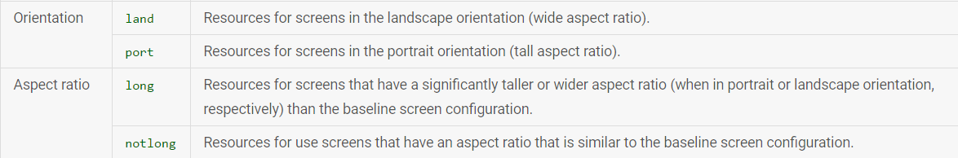
Configuration qualifiers (2/3)

Slide 15
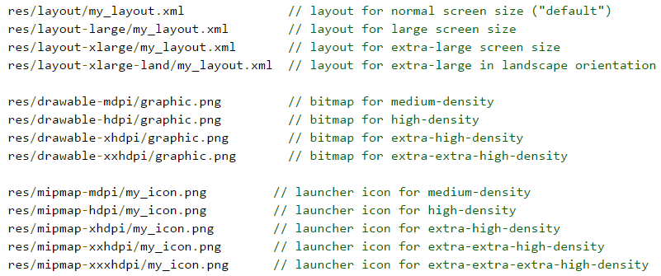
Configuration qualifiers (3/3)
Example

Slide 16
Designing alternative layouts and drawables (1/3)
Alternative layouts

Slide 17
Designing alternative layouts and drawables (2/3)
Alternative drawables
36x36 (0.75x) for low-density
48x48 (1.0x baseline) for medium-density
72x72 (1.5x) for high-density
96x96 (2.0x) for extra-high-density
144x144 (3.0x) for extra-extra-high-density
192x192 (4.0x) for extra-extra-extra-high-density (launcher icon only; see note above)

Slide 18
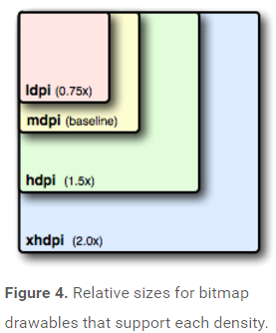
Designing alternative layouts and drawables (3/3)
To create alternative bitmap drawables for different densities, you should follow the 3:4:6:8:12:16 scaling ratio between the six generalized densities.

Slide 19
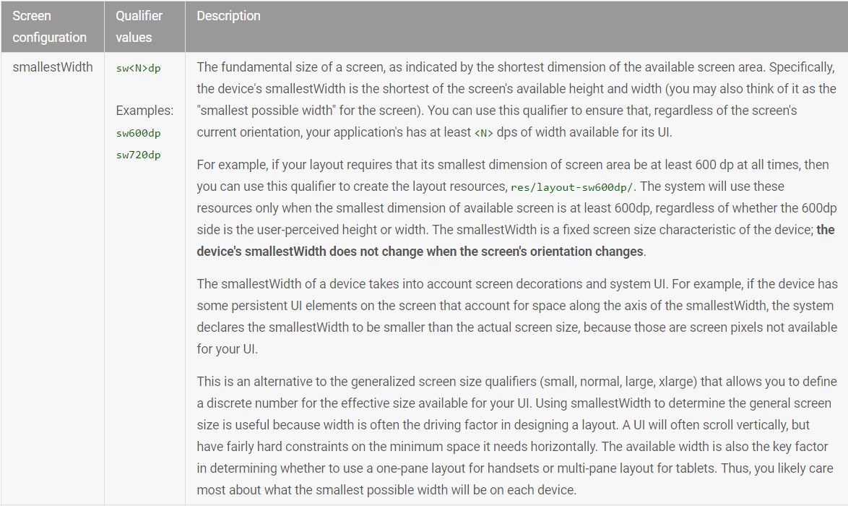
Using new size qualifiers (1/4)
New configuration qualifiers for screen size

Slide 20
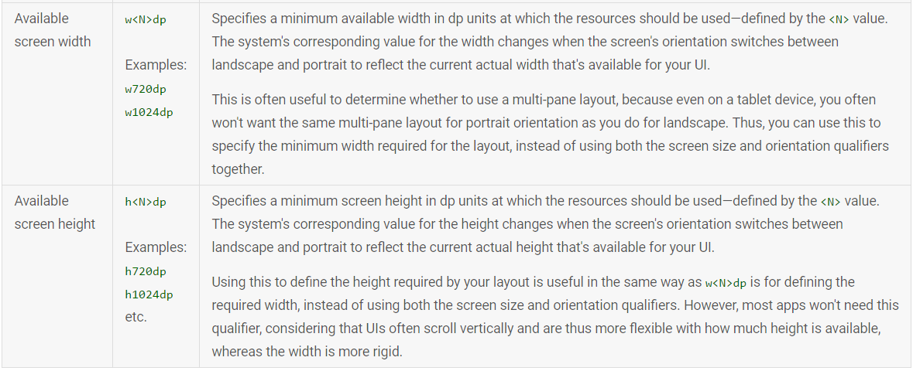
Using new size qualifiers (2/4)

Slide 21
Using new size qualifiers (3/4)
Configuration examples
To help you target some of your designs for different types of devices, here are some numbers for typical screen widths:
320dp: a typical phone screen (240x320 ldpi, 320x480 mdpi, 480x800 hdpi, etc).
480dp: a tweener tablet like the Streak (480x800 mdpi).
600dp: a 7” tablet (600x1024 mdpi).
720dp: a 10” tablet (720x1280 mdpi, 800x1280 mdpi, etc).

Slide 22

Using new size qualifiers (4/4)
example

Slide 23
Best Practices
Use wrap_content, match_parent, or dp units when specifying dimensions in an XML layout file
Do not use hard coded pixel values in your application code
Do not use AbsoluteLayout (it's deprecated)
Supply alternative bitmap drawables for different screen densities (Use size and density-specific resources)

Slide 24
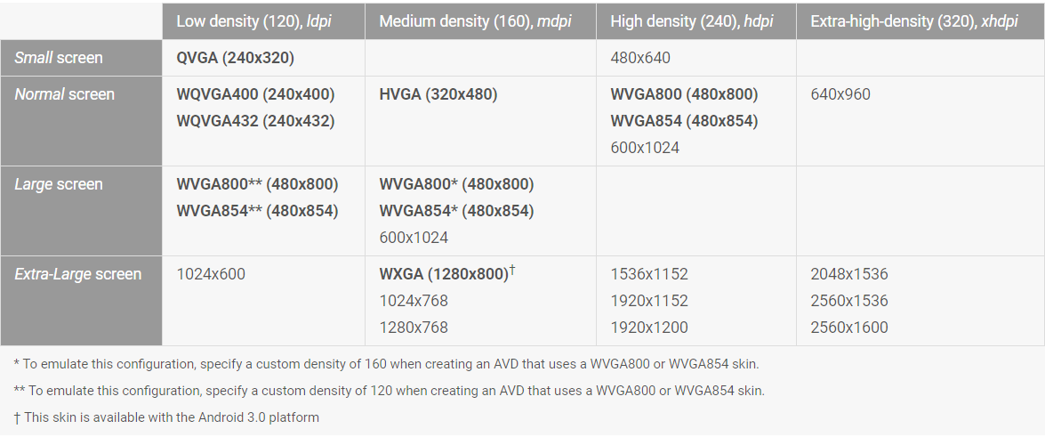
Multiple Screens

